Slide 1
Top UK Companies
By Deividas Petreikis

Slide 2
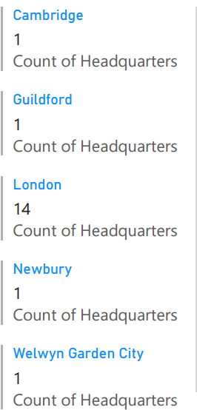
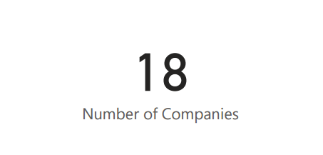
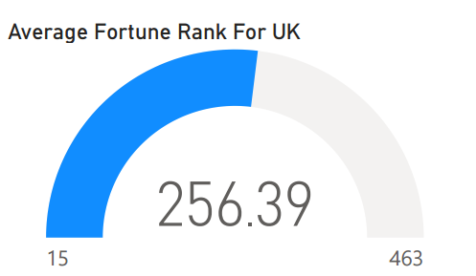
Brief Information of Dataset
Within the dataset there are a total of 18 companies that were present on the Wikipedia list. With the majority of the companies having their headquarters in London totalling 14.
For the UK companies they have been categorised as having the average rank of 256 with the top company being 15 and the lowest being 463.

Slide 3
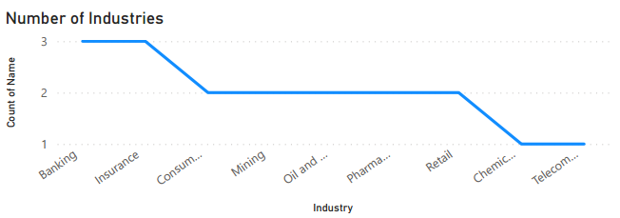
Number of Industires
With all of the companies that are present within the dataset, there are different types of industries that they are a part of.
With the Banking and Insurance industries having the highest of 3 companies each, with the lowest number of industries being Chemical and Telecommunicator having only one each.

Slide 4
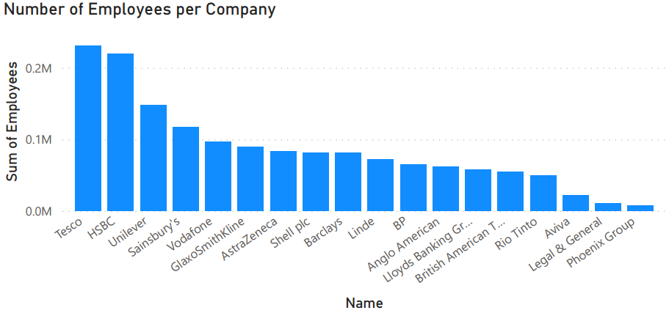
Number of Employees per Company
When looking at which of the companies is ranked the highest for the fortune rank 500. I wanted to look at how much the companies were earning, as well as how many employees they have in order to compare how well the company is doing withing the ranks.
Looking at the bar graphs it show that Tesco and HSBC have the most employees in their companies with Phoenix Group having the least.

Slide 5
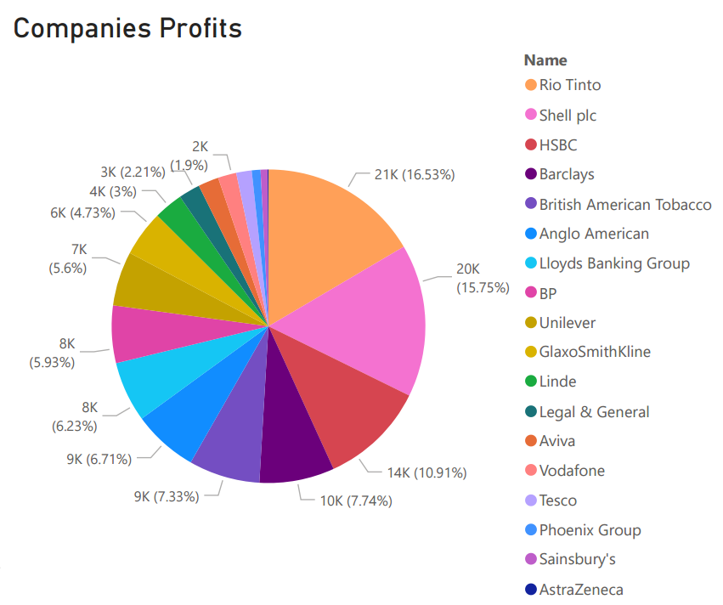
UK Companies Profits
The pie chart shows the companies and their percent of profits amongst all of the companies within the dataset. With Rio Tinto having the highest and AstraZeneca being the lowest.
Comparing the result of the employees and the company profits I see that there is no correlation as HSBC is seen as the third highest for profit and Tesco being in the 15th position.
This is also seen with the two top profit companies as Rio Tinto is the forth lowest in employees while Shell plc is the 8th highest. This makes the search inconclusive for the correlation of employees to profit.

